Slide 1
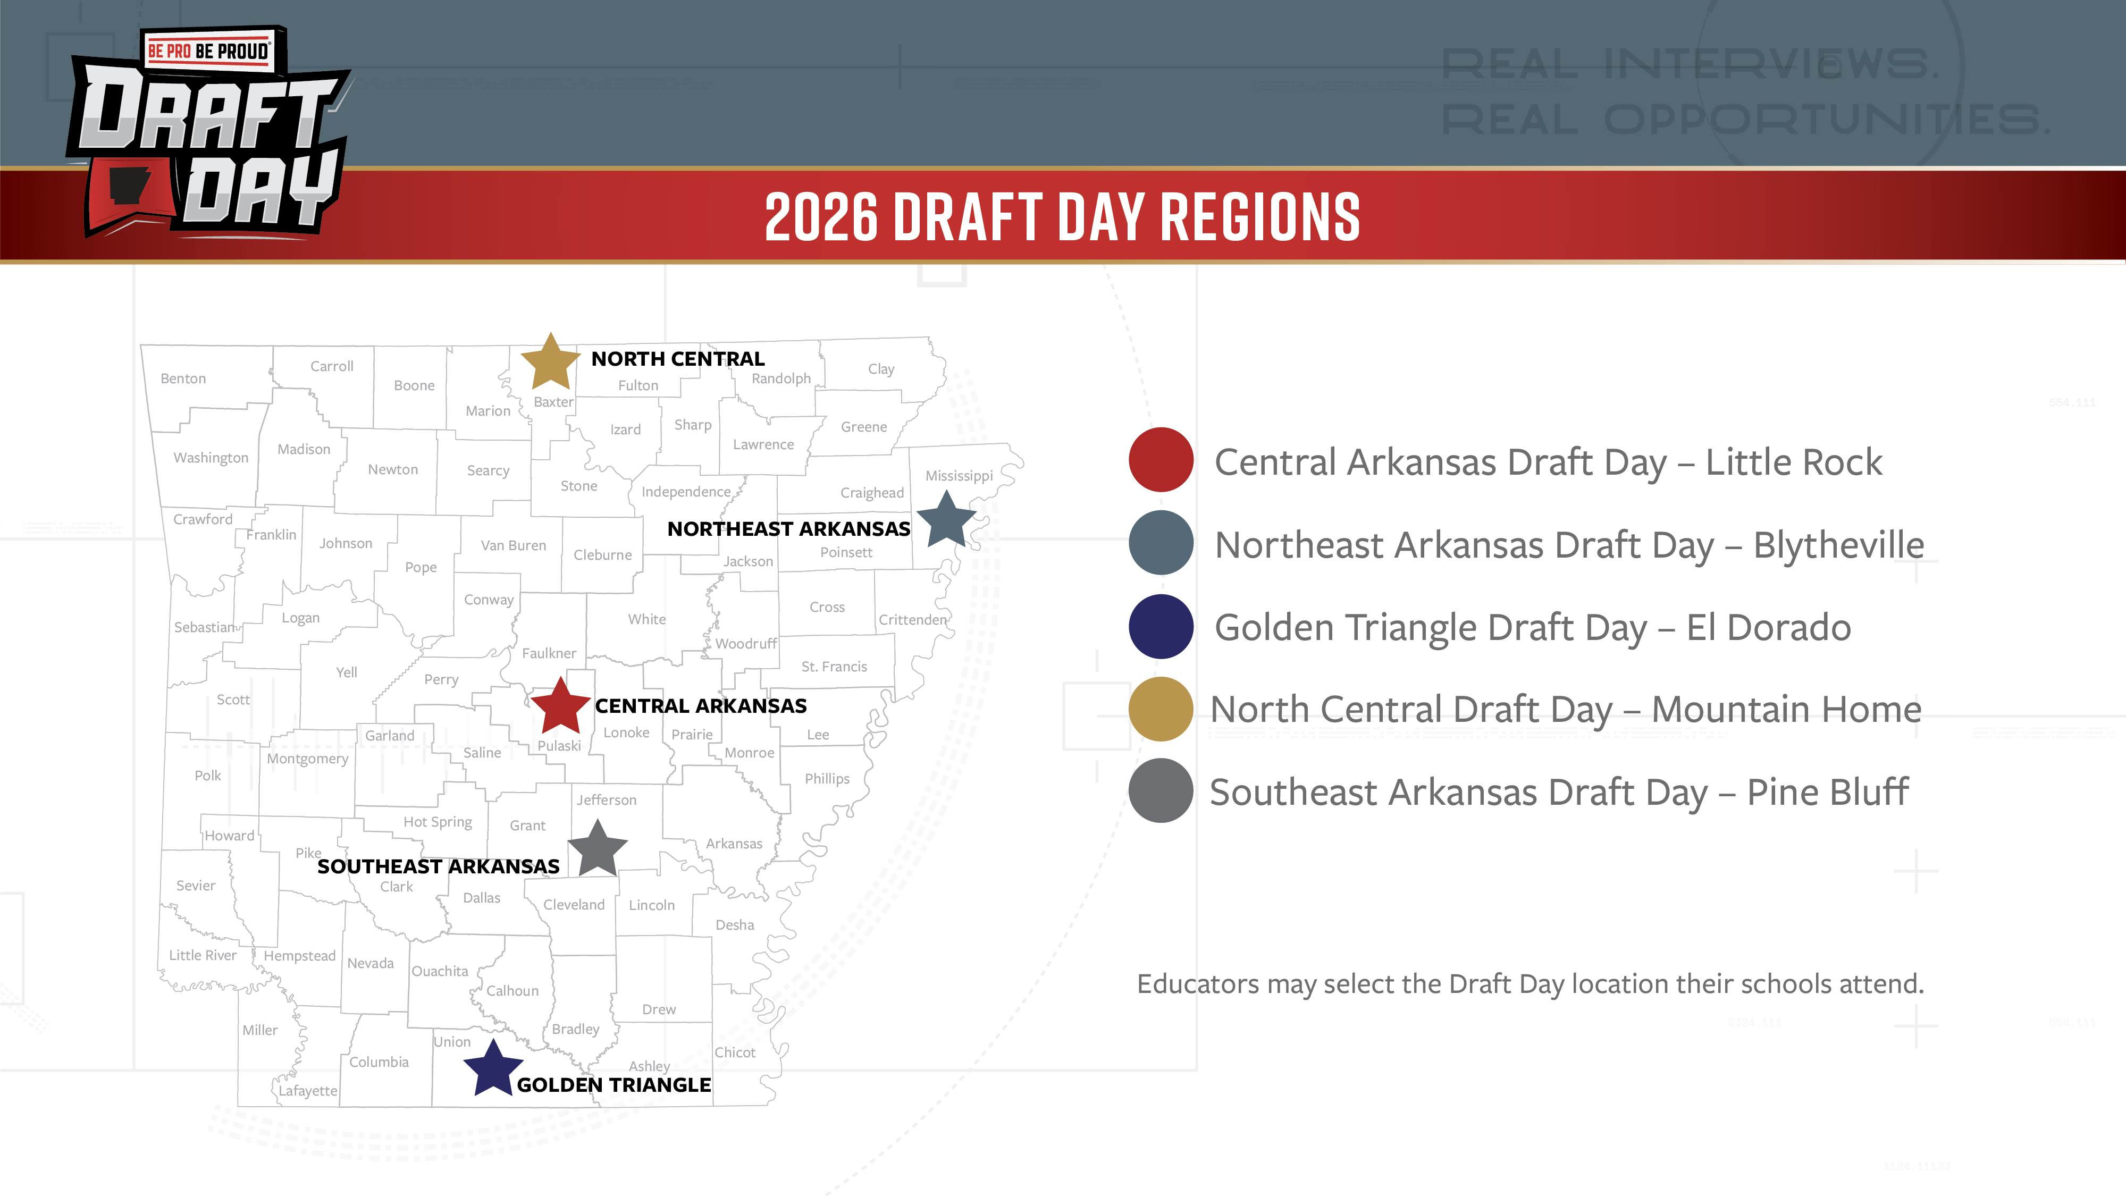

Slide 2
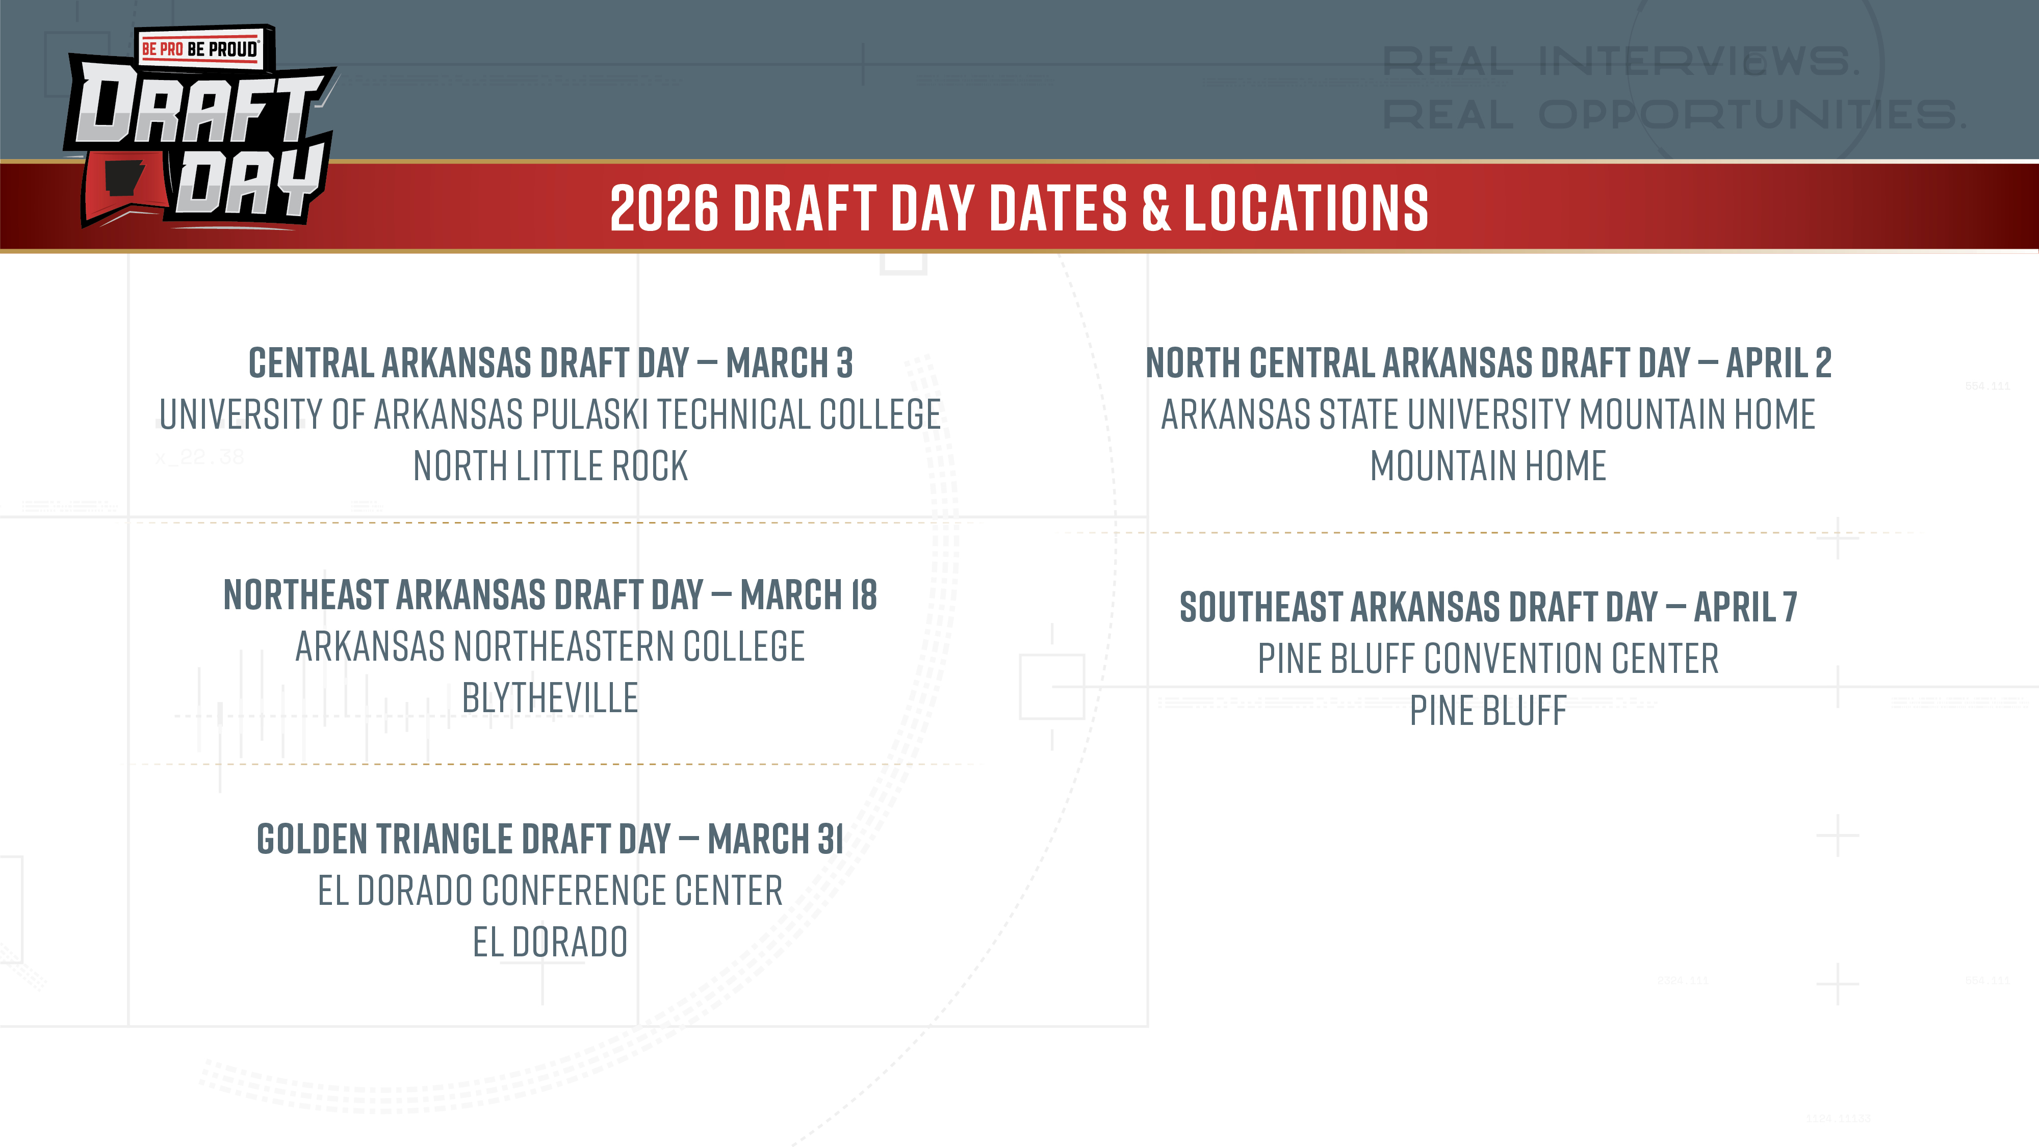

Slide 3


READY FOR WHAT’S NEXT?
BE ON THE LOOKOUT FOR
YOUR SCHOOL’S REGISTRATION EMAIL FROM DANA WEATHERLY!
DON’T SEE YOUR EMAIL? REACH OUT TO DRAFTDAY@BEPROBEPROUD.ORG
Or Register HERE

