Slide 1
Merit Teacher Incentive Fund
2023-2024

Slide 2
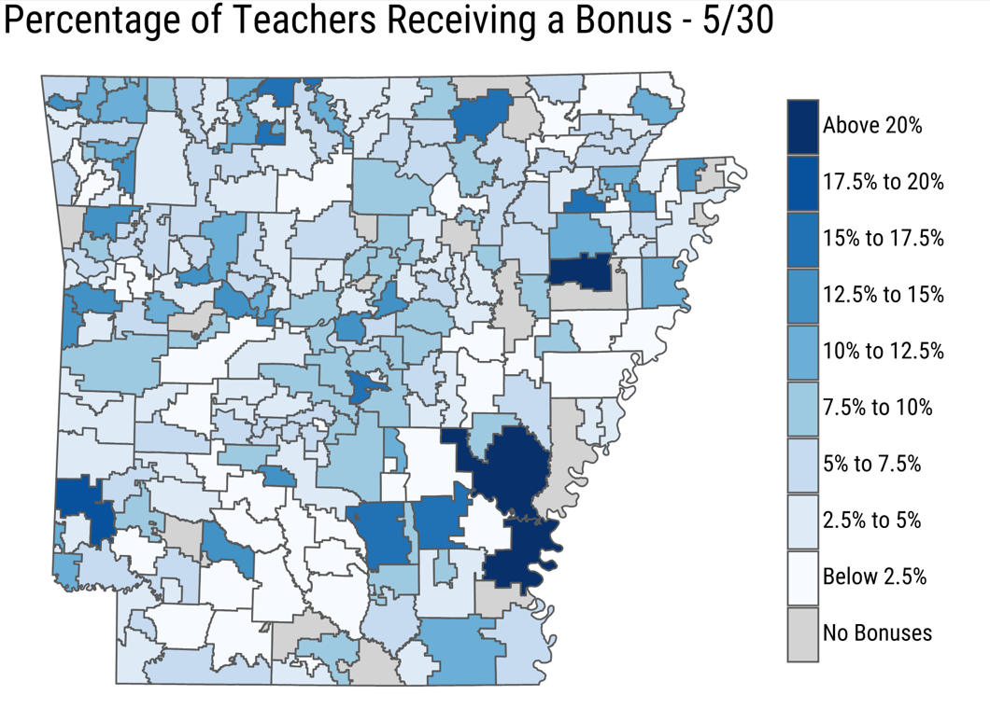
Fast Facts
2023-2024
Merit Pay Incentive Fund= 10 million (fringe paid out of NBCT leftover )
DESE used administrative data to identify all eligible recipients
≈ 3,000 teachers receiving bonuses (almost 10% of Arkansas teachers)
Over 500 teachers receiving >$5,000
Over 40 teachers receiving $10,000
Average bonus ≈ $3,300

Slide 3
Eligibility Categories
ALL licensed classroom teachers, library media specialists, and school counselors
can meet eligibility requirements for at least one category!
End-of-Year (Annual) Rating
of Effective or Higher
Demonstrate outstanding growth in student performance
Teach in a shortage area
(subject, geographical, designation)
Serve as a mentor to an aspiring teacher participating in a yearlong residency

Slide 4
Eligibility Categories
Definitions and Exclusions
Teacher means a:
Licensed classroom teacher who spends at least 70% of his or her contracted time working directly with students in a classroom setting teaching all grade-level or subject-matter appropriate classes;
School Counselor;
Library media specialist;
Aspiring teacher employed under an Aspiring Teacher Permit
Districts will confirm all recipients meet the definition of teacher before funds are distributed.
Must have an effective or higher annual rating in DESE Educator Effectiveness System
If a teacher has an average growth score based on three years of data (2021, 2022, 2023) that is showing students are not meeting expected growth (<80), they are not eligible.

Slide 5
Demonstrate outstanding growth in student performance
Who receives this bonus?
Teachers with a growth score for the 2020-21, 2021-22, and 2022-23 school years are considered for outstanding growth merit incentives.
Teachers with a three-year average student growth score across all subjects in the top 5% of all teachers statewide (up to $10,000)
Teachers with a three-year average student growth score in the same tested subject area (ELA, Math, Sci) that is in the top 25% of all teachers in that subject area statewide ($3,000).
Students not meeting reading/numeracy standards can be assigned to these ELA and math teachers (LEARNS Act).

Slide 6
Serve as a mentor to a yearlong resident
Who receives this bonus?
Evidence of mentoring a yearlong resident submitted by Educator Preparation Program
Minimum 3 years of teaching experience
Lead or Master Professional Educator Designation on Arkansas Standard License
Completion of DESE recognized coaching training
Effective or Highly Effective rating in DESE Educator Effectiveness System
Potentially 2,000 mentors will be needed when the yearlong residency becomes a requirement in the 2026-27 school year

Slide 7
Teach in a Shortage Area
Who receives this incentive category?
Teachers in a subject area experiencing a critical shortage.
Computer Science, Foreign Language, Secondary Math, Secondary Science, Special Education
Teachers in a geographic shortage area.
Arkansas River ESC, Great Rivers ESC, Pulaski Co. Schools, Southeast ESC, Southwest ESC, and other districts identified as high need based on unlicensed teacher and attrition data.
Teachers holding a Lead or Master Professional Educator licensure designation.
Currently, around 1,300 individuals hold these designations. These designations are needed to:
Mentor yearlong residents (approx. 2,000 needed by 2026-27)
Students not meeting readiness standards in Math and/or ELA can be placed with a Master Professional Educator
These teachers must demonstrate a positive impact on student growth by:
Having a 3yr average growth score showing students on average are meeting expected growth (>=80); OR
Receiving an annual rating of “Highly Effective”

Slide 8
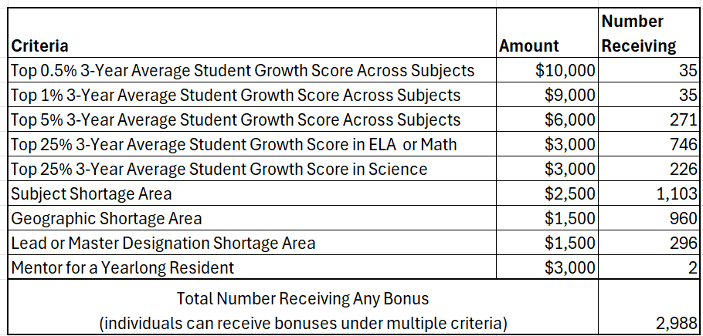
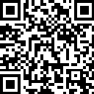
Distribution Map: http://dese.link/Merit2024

